Slide 1



Course: Image Processing 31651
Assignment #11
Synthetic Image Creation (Part 1)-version 2
Photo of the student | Shorten Name | ID (4 last digits)
 | shienfeld | 1950 | Student #1
 | pony | 2210 | Student #2
 | akimov | 7939 | Student #3
Photo of the student | Shorten Name | ID (4 last digits)
 | shienfeld | 1950 | Student #1
 | pony | 2210 | Student #2
 | akimov | 7939 | Student #3

Slide 2
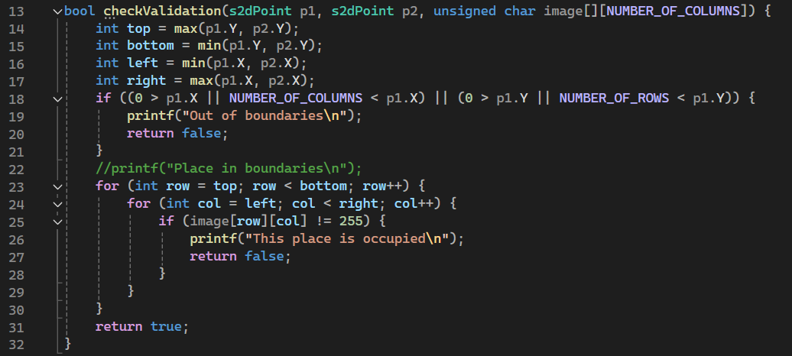
Part 1 of Introduction to 11.1 – apply “checkValidation” function
The checkValidation function is designed to verify whether a given rectangle, defined by two points (p1 and p2), lies within the boundaries of an image and that the region is not already occupied.
In the next slide a more thorough explanation about that function will be presented
2

Slide 3
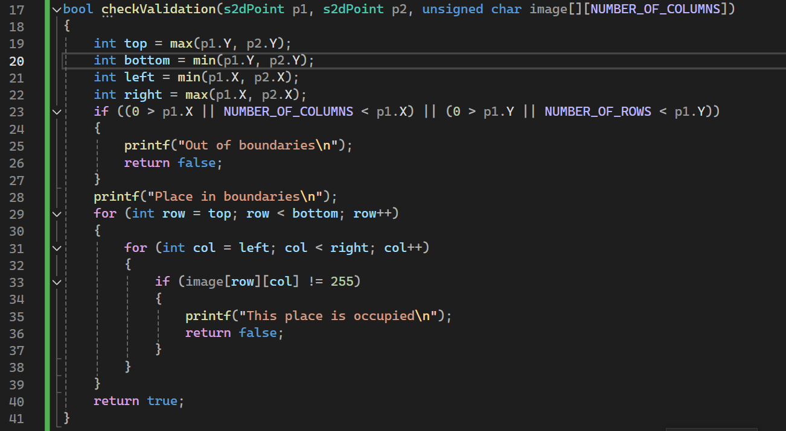

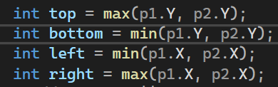
Part 2 of Introduction to 11.1 – apply “checkValidation” function
In the next few slides we will present the “checkValidation” function a bit deeper
First step- Parameters of the function:
s2dPoint p1 → is the first point defining one corner of the rectangle.
s2dPoint p2 → is the second point defining the opposite corner of the rectangle.
unsigned char image[][NUMBER_OF_COLUMNS] → is A 2D array representing the image.
The function returns a Boolean output : true if the rectangle is valid (within boundaries and not occupied), otherwise false.
Second step - define Rectangle Boundaries:
top: The maximum Y-coordinate between p1 and p2.
bottom: The minimum Y-coordinate between p1 and p2.
left: The minimum X-coordinate between p1 and p2.
right: The maximum X-coordinate between p1 and p2.
3

Slide 4
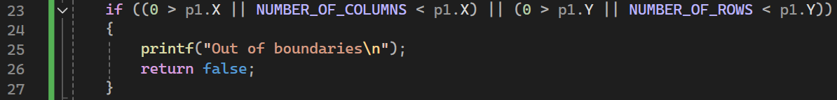
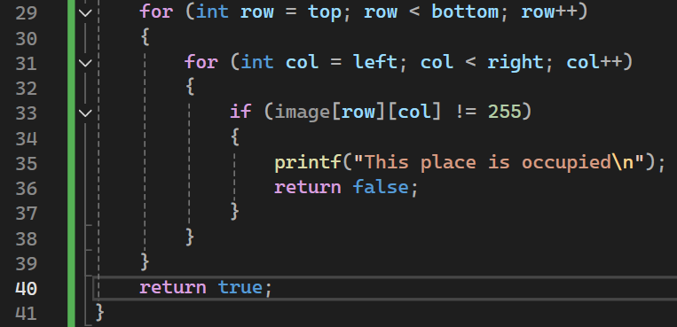
Part 3 of Introduction to 11.1 – apply “checkValidation” function
4
third step – check if a defined point is in or out of bounds:
This part checks if either point p1 is outside the image boundaries. If p1 is out of bounds, it prints "Out of boundaries" and returns false. If within bounds, it prints "Place in boundaries".
fourth step – checking occupancy of pixels within the rectangle:
This loop iterates over the region defined by the rectangle:
Outer loop: Iterates from top to bottom (Y-coordinates).
Inner loop: Iterates from left to right (X-coordinates).
It checks if any pixel within the rectangle is not equal to 255 (assuming 255 represents an unoccupied pixel in a grayscale image).
If it finds an occupied pixel, it prints "This place is occupied" and returns false.

Slide 5
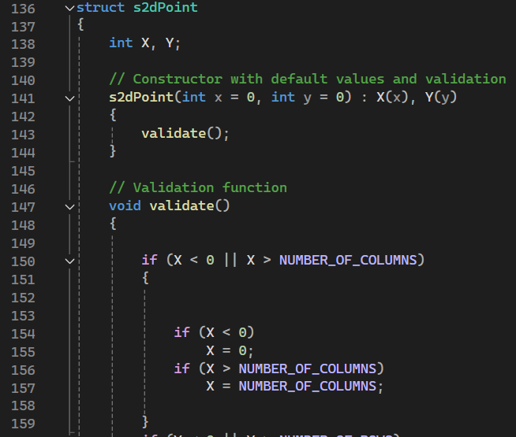
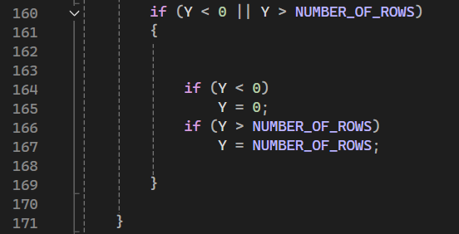
Part 4 of Introduction to 11.1 – apply “s2dpoint” struct (1/2)
5
These are the coordinates of the point. X represents the horizontal coordinate, and Y represents the vertical coordinate.
This is a constructor for the struct. It initializes the member variables X and Y with the values provided (defaulting to 0 if no values are given). After initialization, it calls the validate method to ensure the coordinates are within the allowed range.
The validate function ensures that the coordinates X and Y stay within the bounds defined by NUMBER_OF_COLUMNS and NUMBER_OF_ROWS.
If X is less than 0, it is set to 0. If X is greater than NUMBER_OF_COLUMNS, it is set to NUMBER_OF_COLUMNS. The same logic applies to Y with respect to NUMBER_OF_ROWS.
Pay attention that the s2dPoint struct is defined at the header file to represent a 2D point with X and Y coordinates.

Slide 6
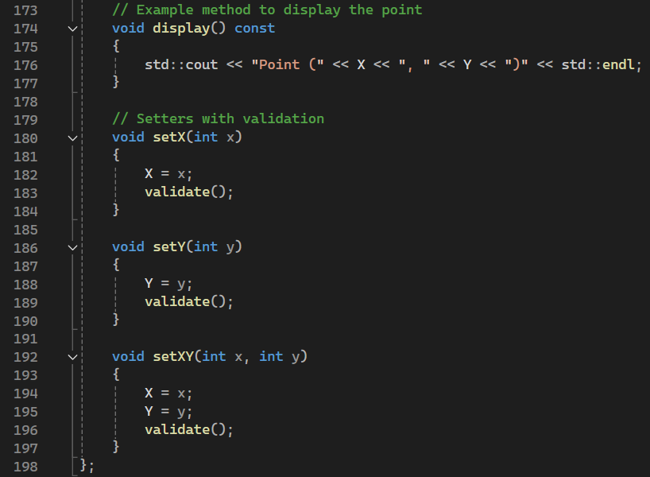
Part 4 of Introduction to 11.1 – apply “s2dpoint” struct (2/2)
The display function prints the coordinates of the point to the standard output. The const keyword indicates that this function does not modify the member variables of the struct.
Setters are functions that allow you to change the values of member variables while ensuring they remain valid.
setX(int x): Sets the X coordinate and validates it.
setY(int y): Sets the Y coordinate and validates it.
setXY(int x, int y): Sets both X and Y coordinates and validates them.
Each part of the s2dpoint struct - ensures that the point's coordinates are always valid and provides a way to manipulate and display the point's data.

Slide 7
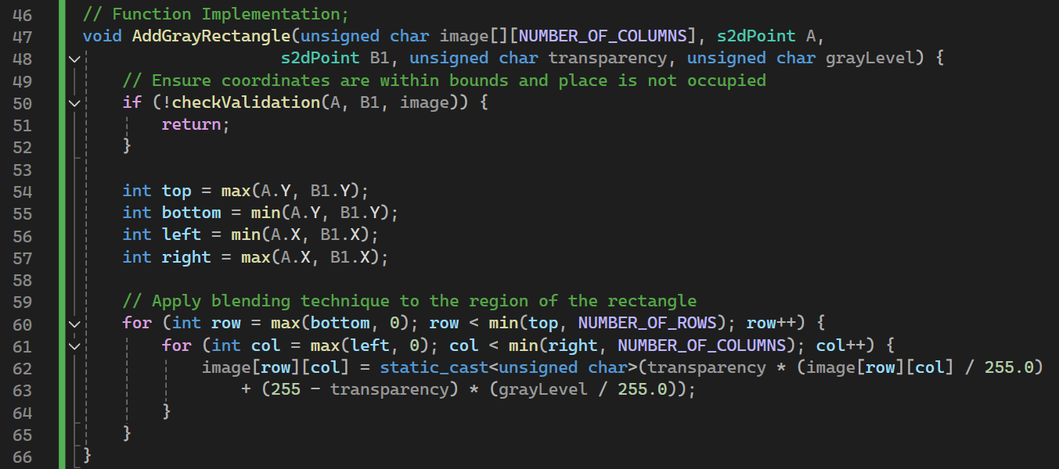
11.1 Code of the function “AddGrayRectangle”
Pay attention that in the code that For each pixel, blend the new gray level using the formula:
image[row][col] = static_cast<unsigned char>(transparency * (image[row][col] / 255.0) + (255 - transparency) * (grayLevel / 255.0));
The AddGrayRectangle function ensures that the specified rectangle is within valid boundaries and not occupied before adding it to the image. It calculates the top, bottom, left, and right boundaries of the rectangle and then applies a blending technique to each pixel within these boundaries to incorporate the rectangle with the specified gray level and transparency.
7

Slide 8
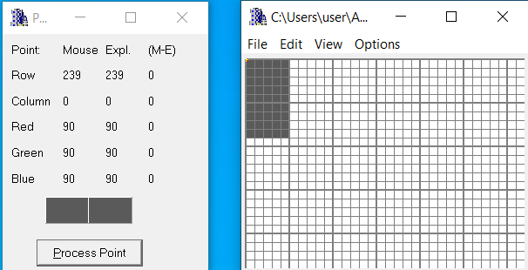

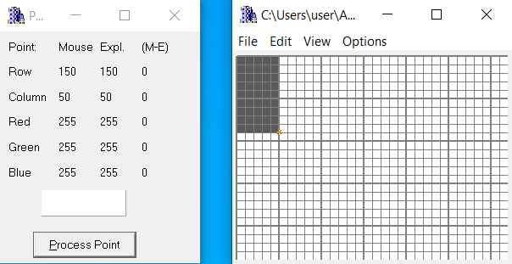

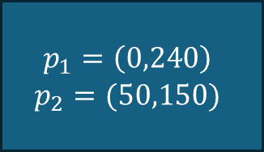



11.2 List of situations tested – part 1
$$p_{1}$$
$$(320,239)$$
$$p_{2}$$
$$(0,0)$$
This test image will be listed as #1
$$p_{1}=\left(0,240\right)$$
$$p_{2}=(50,150)$$

Slide 9
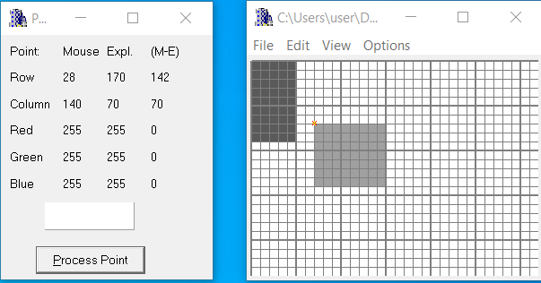

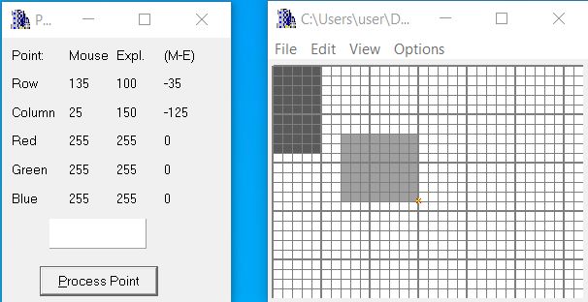

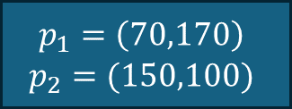



11.2 List of situations tested – part 2
$$(320,240)$$
$$p_{1}$$
$$p_{2}$$
$$(0,0)$$
This test image will be listed as #2
$$p_{1}=\left(70,170\right)$$
$$p_{2}=(150,100)$$

Slide 10
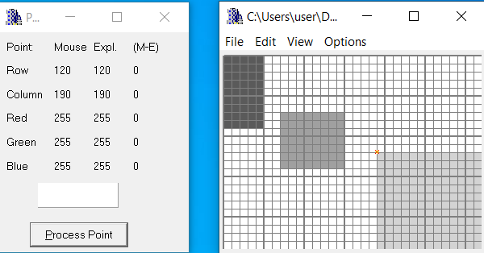

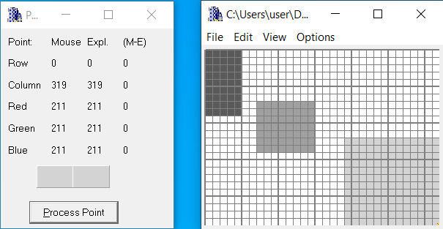

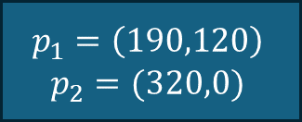



11.2 List of situations tested – part 3
$$(320,240)$$
$$p_{1}$$
$$p_{2}$$
$$(0,0)$$
This test image will be listed as #3
$$p_{1}=\left(190,120\right)$$
$$p_{2}=(320,0)$$

Slide 11
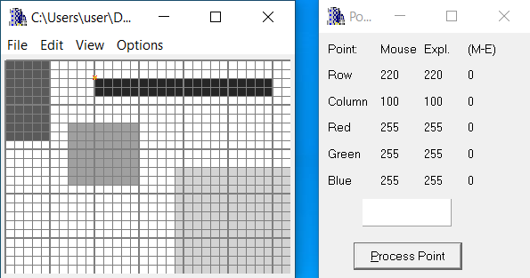

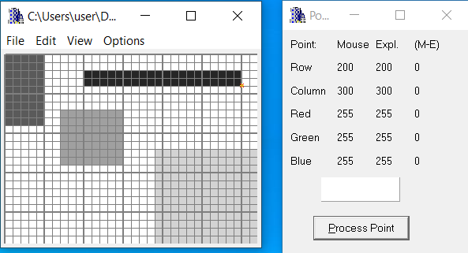

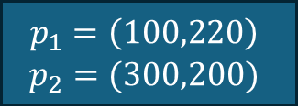



11.2 List of situations tested – part 4
$$p_{1}$$
$$(320,240)$$
$$p_{2}$$
$$(0,0)$$
This test image will be listed as #4
$$p_{1}=\left(100,220\right)$$
$$p_{2}=(300,200)$$

Slide 12
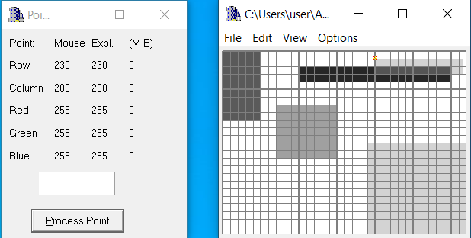

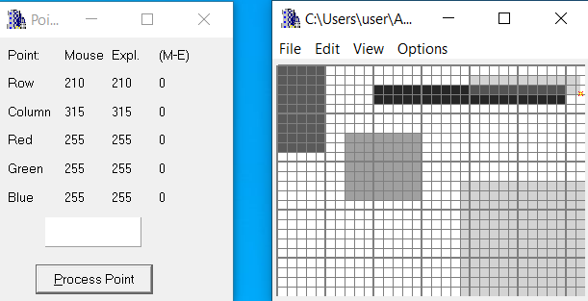

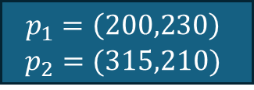



11.2 List of situations tested – part 5
$$p_{1}$$
$$(320,240)$$
$$p_{2}$$
$$(0,0)$$
This test image will be listed as #5
$$p_{1}=\left(200,230\right)$$
$$p_{2}=(315,210)$$

Slide 13
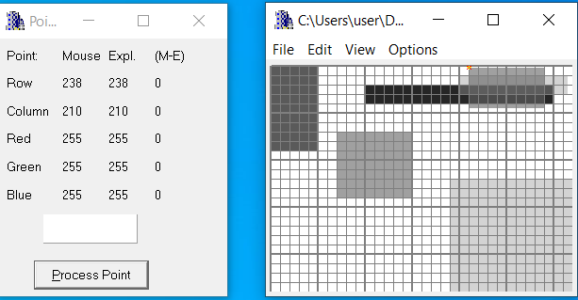

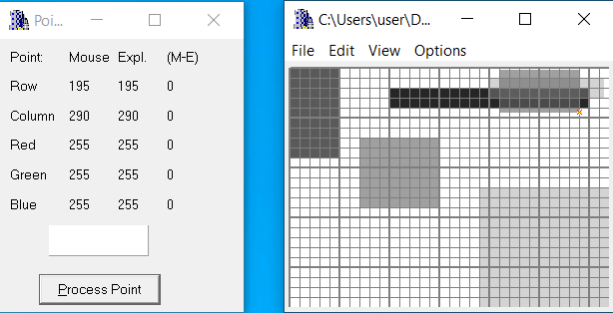




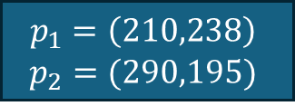
11.2 List of situations tested – part 6
$$p_{1}$$
$$(320,240)$$
$$p_{2}$$
$$(0,0)$$
This test image will be listed as #5
$$p_{1}=\left(210,238\right)$$
$$p_{2}=(290,195)$$

Slide 14
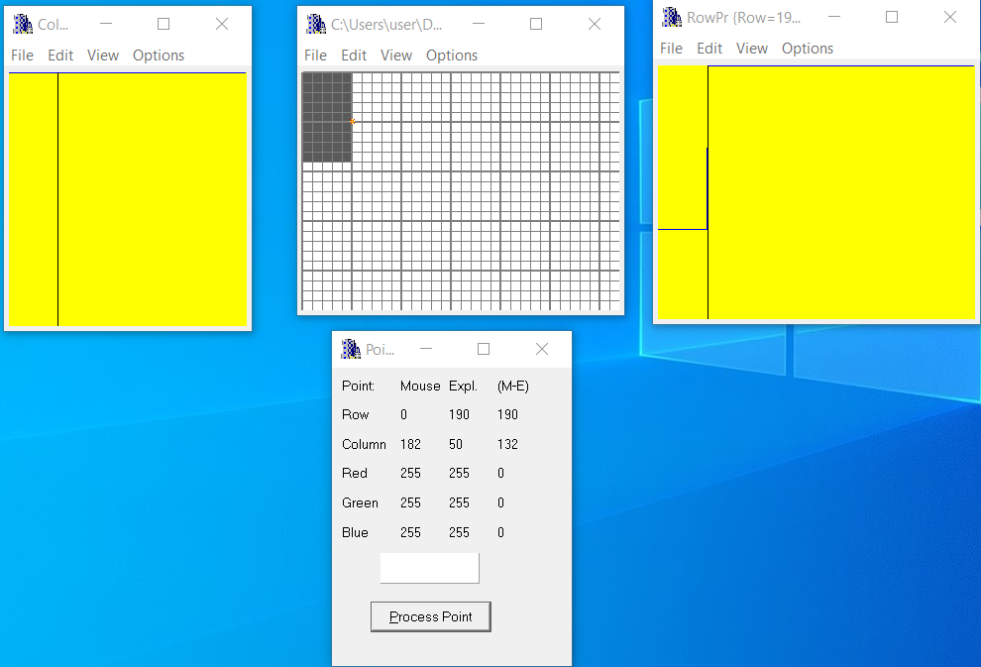

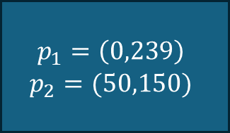



11.3 For the specific test images (see 11.2), put relevant profiles
and refer relevant lines of code to prove that specific test having specific rectangle were created as required – part 1
Regarding test image #1 – we look at the border of the rectangle and can see a clear step (like a step function) in the rows view.
$$p_{1}$$
$$(320,239)$$
$$p_{2}$$
$$(0,0)$$
$$p_{1}=\left(0,239\right)$$
$$p_{2}=(50,150)$$

Slide 15
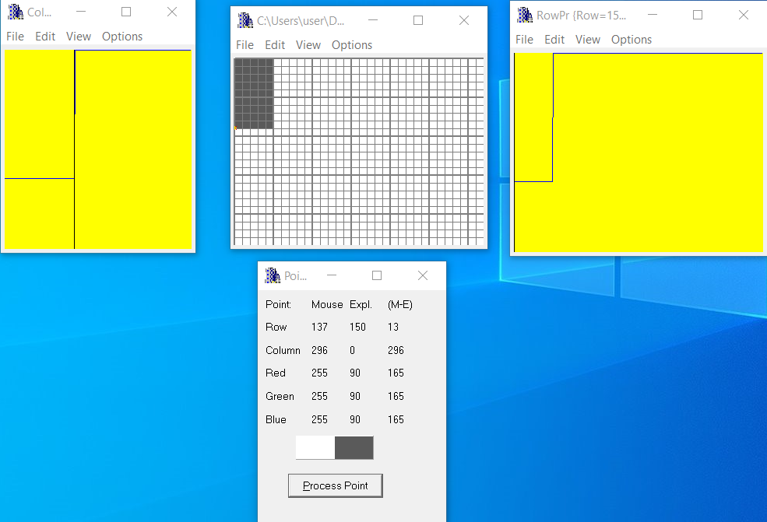

11.3 For the specific test images (see 11.2), put relevant profiles
and refer relevant lines of code to prove that specific test having specific rectangle were created as required – part 2
Regarding test image #1 – we look at the border of the rectangle and can see a clear step (like a step function) in the columns view.
$$p_{1}$$
$$(320,240)$$
$$p_{2}$$
$$(0,0)$$
$$p_{1}=\left(0,239\right)$$
$$p_{2}=(50,150)$$

Slide 16
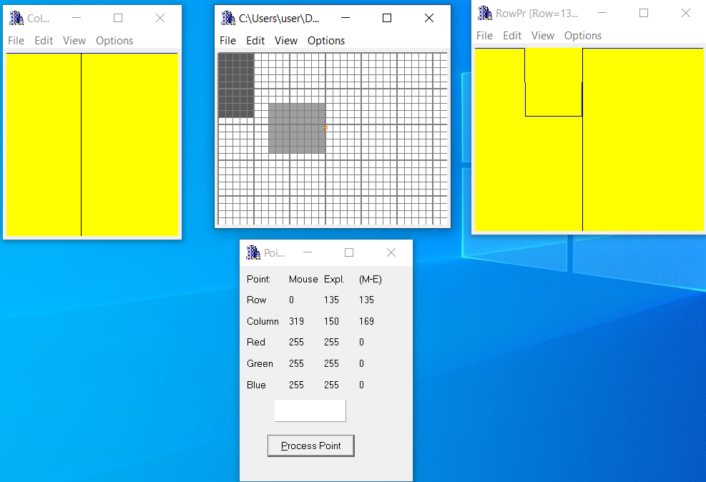

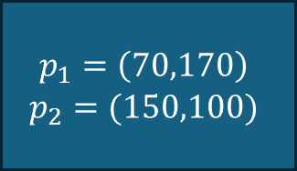



11.3 For the specific test images (see 11.2), put relevant profiles
and refer relevant lines of code to prove that specific test having specific rectangle were created as required – part 3
$$(320,240)$$
Regarding test image #2 – we look at the border of the rectangle and can see a clear hole (like a potential hole) in the rows view. The hole is between the borders of the second rectangle
$$p_{1}$$
$$p_{2}$$
$$(0,0)$$
$$p_{1}=\left(70,170\right)$$
$$p_{2}=(150,100)$$

Slide 17





11.3 For the specific test images (see 11.2), put relevant profiles
and refer relevant lines of code to prove that specific test having specific rectangle were created as required – part 4
Regarding test image #2 – we look at the border of the rectangle and can see a clear hole (like a potential hole) in the columns view. The hole is between the borders of the second rectangle
$$(320,240)$$
$$p_{1}$$
$$p_{2}$$
$$p_{1}=\left(70,170\right)$$
$$p_{2}=(150,100)$$

Slide 18
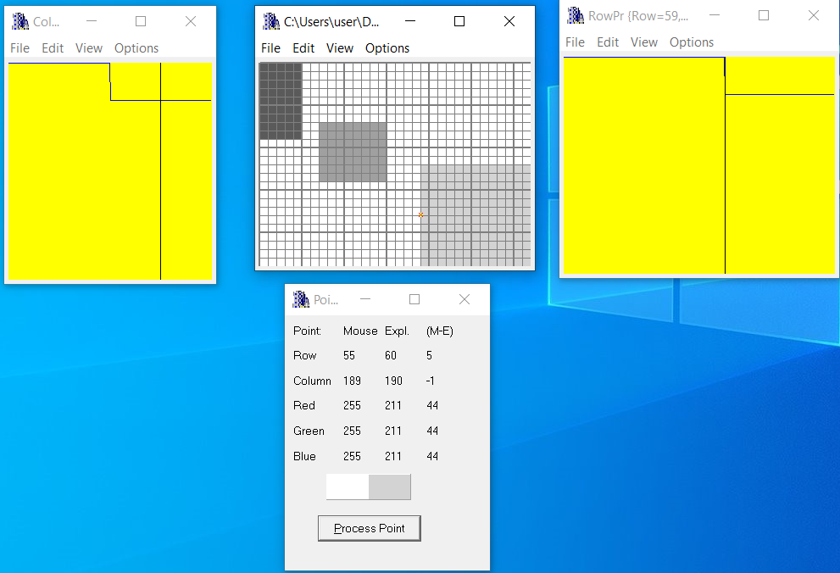
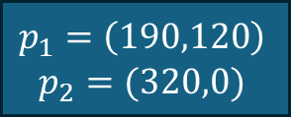

11.3 For the specific test images (see 11.2), put relevant profiles
and refer relevant lines of code to prove that specific test having specific rectangle were created as required – part 5
Regarding test image #3 – we look at the border of the rectangle and can see a step small in the rows view. The step is between the borders of the third rectangle
$$(320,240)$$
$$p_{1}$$
$$p_{2}$$
$$(0,0)$$
$$p_{1}=\left(190,120\right)$$
$$p_{2}=(320,0)$$

Slide 19

11.3 For the specific test images (see 11.2), put relevant profiles
and refer relevant lines of code to prove that specific test having specific rectangle were created as required – part 6
Regarding test image #3 – we look at the border of the rectangle and can see a step small in the columns view. The step is between the borders of the third rectangle
$$(320,240)$$
$$p_{1}$$
$$p_{2}$$
$$(0,0)$$
$$p_{1}=\left(190,120\right)$$
$$p_{2}=(320,0)$$

Slide 20
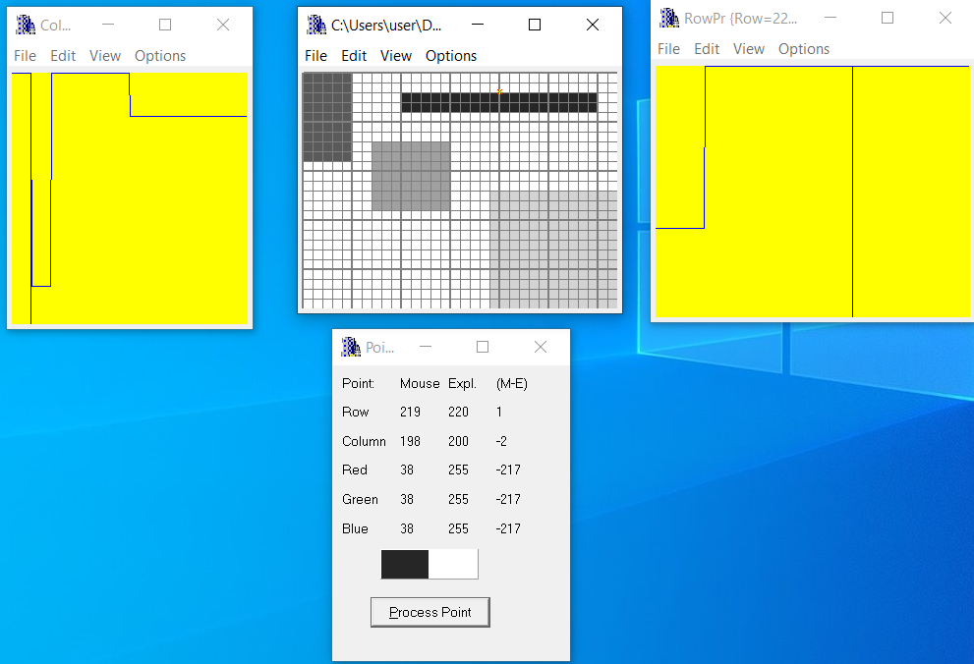





11.3 For the specific test images (see 11.2), put relevant profiles
and refer relevant lines of code to prove that specific test having specific rectangle were created as required – part 7
$$(320,240)$$
$$p_{1}$$
$$p_{2}$$
$$(0,0)$$
$$p_{1}=\left(100,220\right)$$
$$p_{2}=(300,200)$$

Slide 21
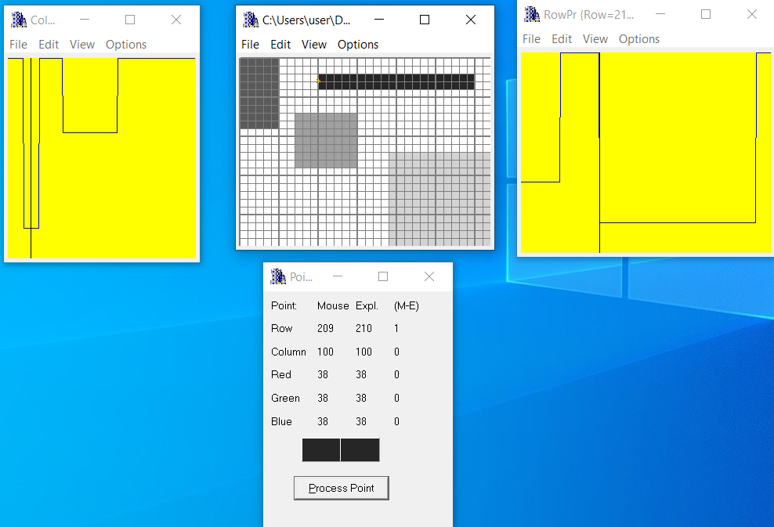
11.3 For the specific test images (see 11.2), put relevant profiles
and refer relevant lines of code to prove that specific test having specific rectangle were created as required – part 8
$$(320,240)$$
$$p_{1}$$
$$p_{2}$$
$$(0,0)$$
$$p_{1}=\left(100,220\right)$$
$$p_{2}=(300,200)$$

Slide 22
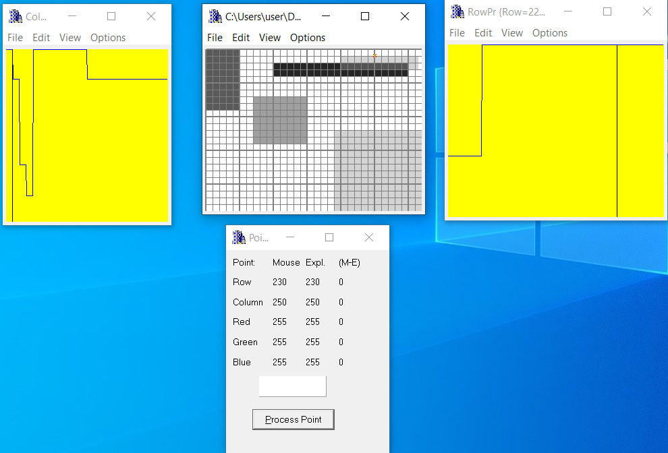

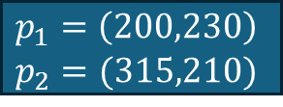



11.3 For the specific test images (see 11.2), put relevant profiles
and refer relevant lines of code to prove that specific test having specific rectangle were created as required – part 9
$$p_{1}$$
$$(320,240)$$
$$p_{2}$$
$$(0,0)$$
$$p_{1}=\left(200,230\right)$$
$$p_{2}=(315,210)$$

Slide 23
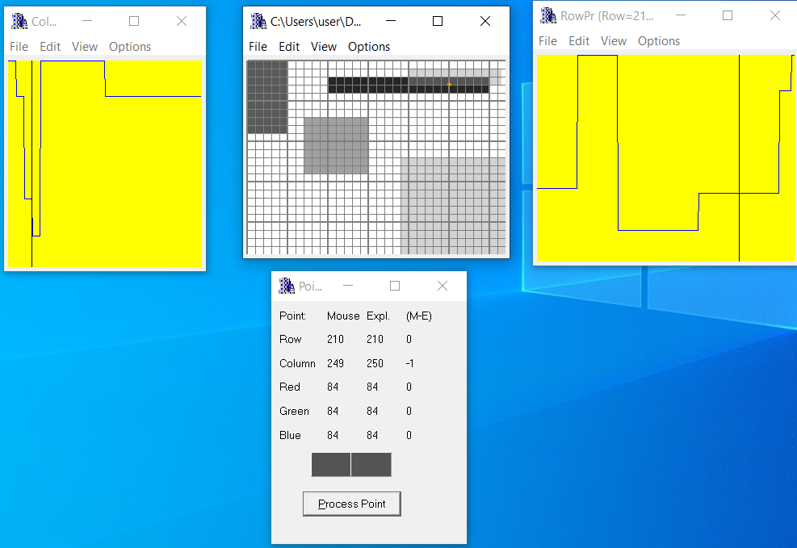

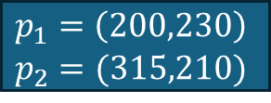



11.3 For the specific test images (see 11.2), put relevant profiles
and refer relevant lines of code to prove that specific test having specific rectangle were created as required – part 10
$$p_{1}$$
$$(320,240)$$
$$p_{2}$$
$$(0,0)$$
$$p_{1}=\left(200,230\right)$$
$$p_{2}=(315,210)$$

Slide 24


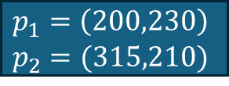



11.3 For the specific test images (see 11.2), put relevant profiles
and refer relevant lines of code to prove that specific test having specific rectangle were created as required – part 11
$$p_{1}$$
$$(320,240)$$
$$p_{2}$$
$$(0,0)$$
$$p_{1}=\left(200,230\right)$$
$$p_{2}=(315,210)$$

Slide 25
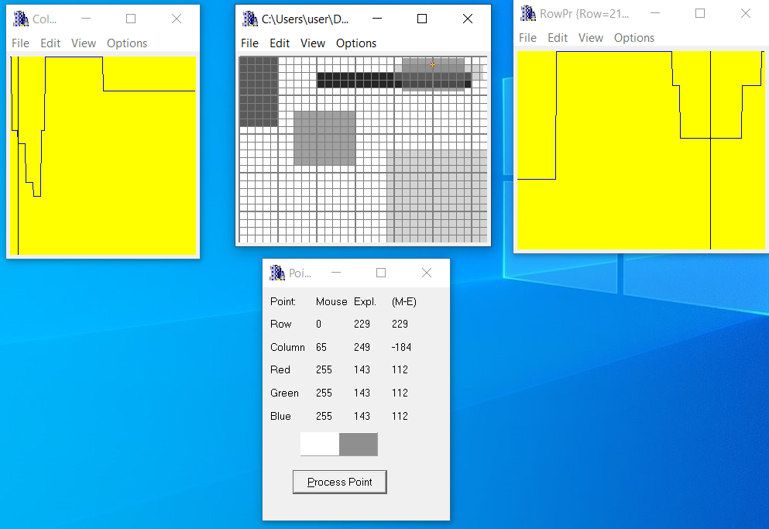



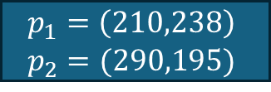

11.3 For the specific test images (see 11.2), put relevant profiles
and refer relevant lines of code to prove that specific test having specific rectangle were created as required – part 12
$$p_{1}$$
$$(320,240)$$
$$p_{2}$$
$$(0,0)$$
$$p_{1}=\left(210,238\right)$$
$$p_{2}=(290,195)$$

Slide 26
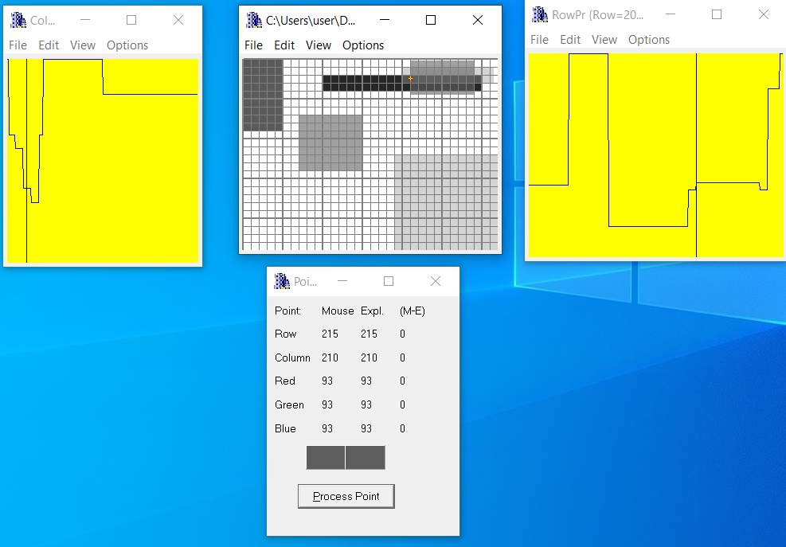


11.3 For the specific test images (see 11.2), put relevant profiles
and refer relevant lines of code to prove that specific test having specific rectangle were created as required – part 13
$$p_{1}$$
$$(320,240)$$
$$p_{2}$$
$$(0,0)$$
$$p_{1}=\left(210,238\right)$$
$$p_{2}=(290,195)$$

Slide 27
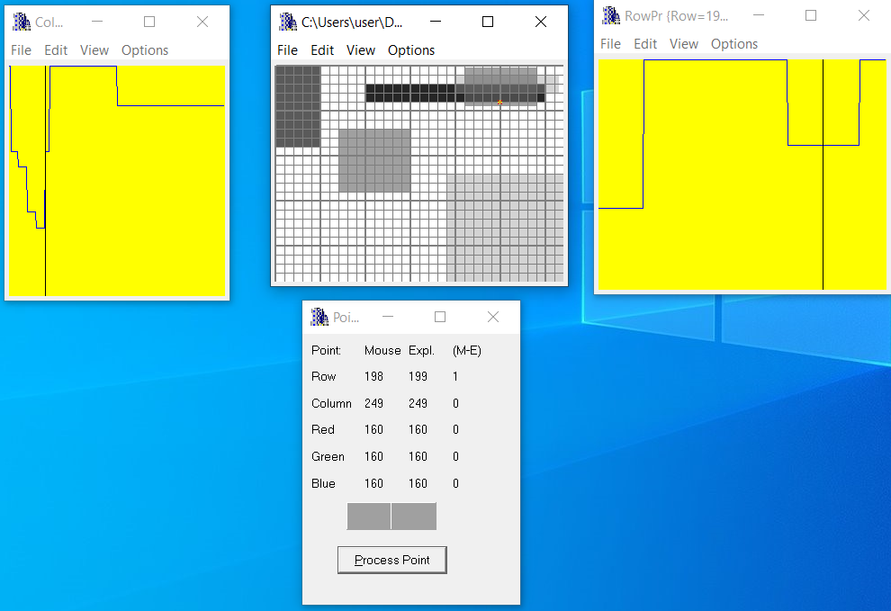



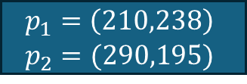

11.3 For the specific test images (see 11.2), put relevant profiles
and refer relevant lines of code to prove that specific test having specific rectangle were created as required – part 14
$$p_{1}$$
$$(320,240)$$
$$p_{2}$$
$$(0,0)$$
$$p_{1}=\left(210,238\right)$$
$$p_{2}=(290,195)$$

Slide 28
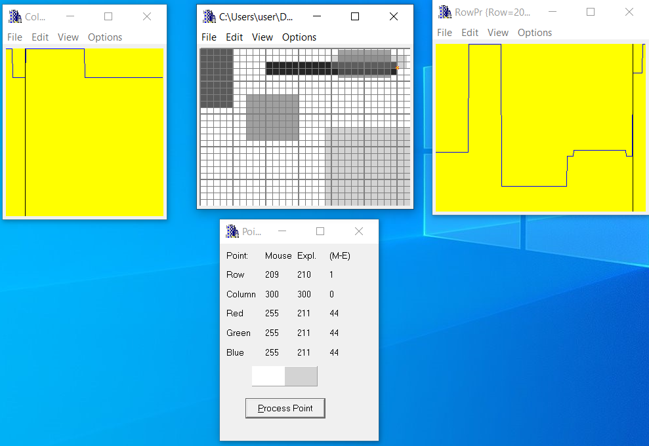
11.3 For the specific test images (see 11.2), put relevant profiles
and refer relevant lines of code to prove that specific test having specific rectangle were created as required – part 15
$$p_{1}$$
$$(320,240)$$
$$p_{2}$$
$$(0,0)$$
$$p_{1}=\left(210,238\right)$$
$$p_{2}=(290,195)$$

Slide 29
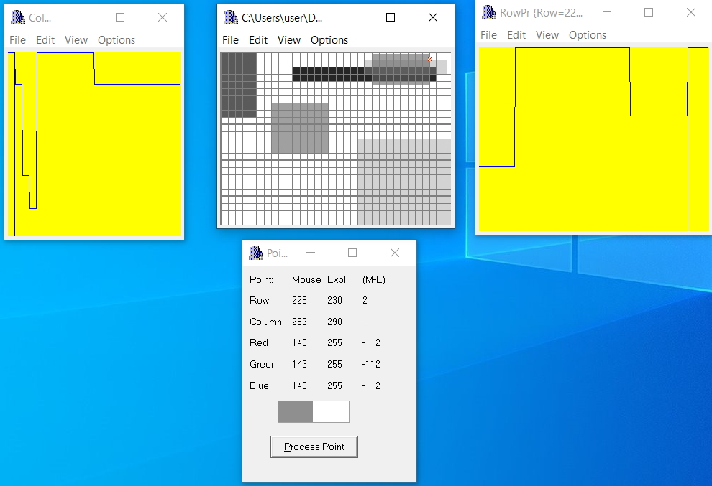
11.3 For the specific test images (see 11.2), put relevant profiles
and refer relevant lines of code to prove that specific test having specific rectangle were created as required – part 16
$$p_{1}$$
$$(320,240)$$
$$p_{2}$$
$$(0,0)$$
$$p_{1}=\left(210,238\right)$$
$$p_{2}=(290,195)$$

Slide 30
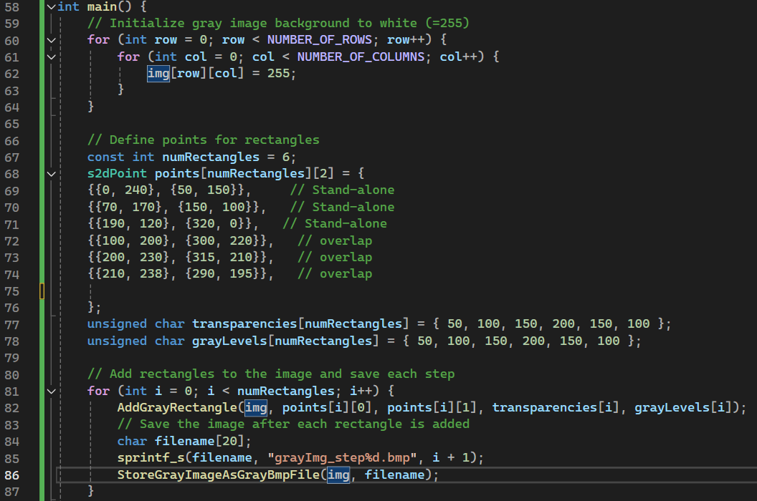
11.4 Code of the “main” function and set of intermediate images-part 1
This nested loop initializes a 2D array img representing the image. Each pixel in the image is set to 255, which represents white in a grayscale image. The loop iterates over all rows and columns of the image, ensuring the entire background is white.
points is a 2D array of s2dPoint structures, where each rectangle is defined by two points (top-left and bottom-right corners).
This arrays stores the transparencies and gray levels for each rectangle.
This for loop save an image in the folder of the project after every iteration – in order to show a step-by-step creation of the rectangles
30

Slide 31
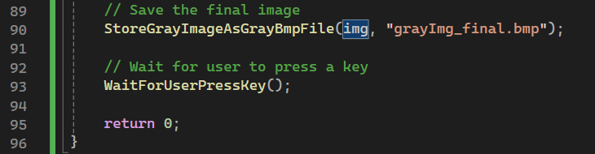
11.4 Code of the “main” function and set of intermediate images-part 2
Calls the function StoreGrayImageAsGrayBmpFile to save the image img as a BMP file named "grayImg11.bmp".

Slide 32
11.4 Code of the “main” function and set of intermediate images-part 3
series of intermediate images created in the main step by step with proper explanations
Step 1 to step 6 of the creation of the rectangles

Slide 33
11.5 what did we learned?
We learned how to create a base image.
We learned how to draw on an existing image.
We learned about the use of transparency and gray level of an image
We learned to find the coordinate (0,0) on the screen
We learned to create a rectangle of gray levels
We learned to draw several rectangles in one drawing in different places in the picture

